Slide 1
Chapter 21: Auditing/Logging
Overview
What is auditing?
What does an audit system look like?
How do you design an auditing system?
Auditing mechanisms
Examples

Slide 2
What is Auditing?
Logging
Recording events or statistics to provide information about system use and performance
Auditing
Analysis of log records to present information about the system in a clear, understandable manner
Auditing is also where an outside organization comes to your organization and evaluates your organization
Security audits are very important
The audit can be by a group within your company or by another company
Compliance usually requires external and internal audits
For this reason, logging and log analysis are also called auditing
Regulations require logging
Payment Card Industry Data Security Standard (PCI DSS) requires log management
Sarbanes-Oxley Act (corporate accountability act) requires privileged user reporting

Slide 3
Uses
Describe security state
Determine if system enters unauthorized state,
E.g., intrusion detection
Evaluate effectiveness of protection mechanisms
Determine which mechanisms are appropriate and working
E.g., user stephan is not allowed to run programs with root access, but the log shows that stephan started a program and the program gained root privilege.
Perform forensics after an attack has been detected
Deter attacks because of presence of record
E.g., the log shows that stephan did not follow company policy
Non-security
Understand performance
Detect failures
Debug failures

Slide 4
What type of data is logged

Slide 5
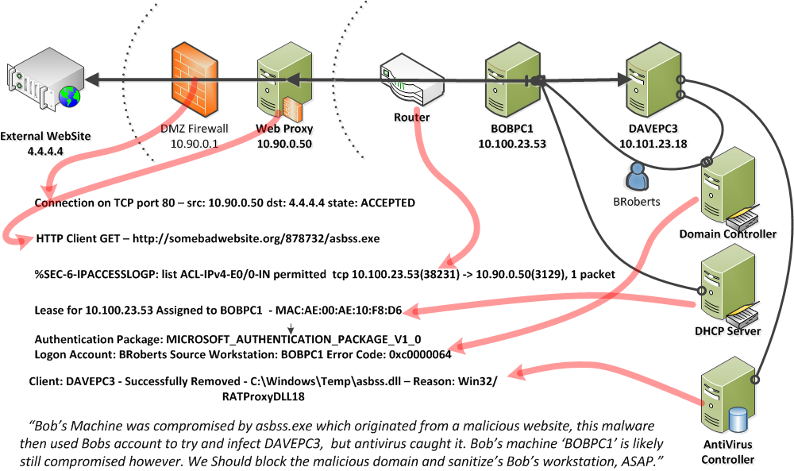
Logging + Analysis: An Example
Notes:
Last entry: DavePC3 was attacked. Virus protection caught asbss.dll
Earlier entries show that asbss was downloaded onto bob’s machine

Slide 6
Challenges
What do you log?
Hint: looking for violations of a policy, so at least the record will show such violations
E.g., Stephan cannot run programs with root privilege. Need to check that which programs run at root privilege and who started the program.
If you plan to perform analysis after an event, you need logs related to the event, which has not yet happened.
.e.g, currports shows which ports are currently open. This will not help when the problem occurred a few days ago.
Usually, collect more logs than you will ever need
10TB / month is possible for a large company
What do you audit?
Need not audit everything
Key: what is the policy involved?
Takes time and experience
Manual inspection of logs is very time consuming and should be reserved to few cases and performed by people who do not enjoy daylight
Some tools are useful
We will look at some tools

Slide 7
Logger
Type and quantity of information recorded is controlled by system or program configuration parameters
May be human readable or not
If not, usually viewing tools supplied
Binary is more efficient then text (but text can be compressed, so…)
Space available, portability influence storage format
Most loggers are human readable, i.e., not binary
Nearly all logs are should not be read by normal people (i.e., the ones that enjoy daylight)

Slide 8
Logging
All applications have logs
If not, then don’t use that app in your enterprise
When writing apps, logging is critical
You will get fired if you don’t have you app logging figured out
For java, use log4j (Apache software foundation)
Many applications have logging that needs to be configured
Apache web server log:
Use module mod_log_config
Allows you to specify
the log format and define which information to collect
where the recorded data is saved, or to which process gets the data
CustomLog logs/detailed_log “%t %a %A %T %B %o %D %H %P %U %q %v %X”
Time of request, remote ip address, local ip address, server response time,, size of response, header, process id that server request, .. And saves to logs/detailed_log
Log files may contain information supplied directly by the client. Therefore, it is possible for malicious clients to insert control-characters in the log files, so care must be taken in dealing with raw logs.
Apps that face the network must be hardened
Assumption: App that do not work with network traffic are not subject to attacks.
Analyzers of logs are, in a sense, working with network traffic.
Which apps are not subject to network traffic
MS word? MS excel? Internal database?
E.g., log generates a report that is read in MS Word.

Slide 9
Example: MS Windows
Control panel -> administrative tools -> event viewer
Control Panel -> System and Security -> administrative tools -> event viewer
Different logs for different types of events
System event logs record system crashes, component failures, and other system events
Application event logs record events that applications request be recorded
Security event log records security-critical events such as user log-in and log-out, system file accesses, and other events
Logs are binary; use event viewer to see them
If log is full (i.e., no more room on the disk), can shut down the system, logging disabled, or logs overwritten
Logs full (i.e., no space on drive) is said to be the single most common cause of mysql database failure

Slide 10
Windows NT Sample Entry
Date: 2/12/2000 Source: Security
Time: 13:03 Category: Detailed Tracking
Type: Success EventID: 592
User: WINDSOR\Administrator
Computer: WINDSOR
Description:
A new process has been created:
New Process ID: 2216594592
Image File Name:
\Program Files\Internet Explorer\IEXPLORE.EXE
Creator Process ID: 2217918496
User Name: Administrator
FDomain: WINDSOR
Logon ID: (0x0,0x14B4c4)
[would be in graphical format]

Slide 11
MS Windows Detailed Logging
Start-> search box: perfmon
Left hand frame: Data Collection Sets->System->System Diagnostics. Select Start (green arrow on tool bar)
Runs for a while. Right click to stop, or it stops by itself
Right click on System Diagnotics -> Latest Report (should have the date)
View CPU, network, etc
Make your own log
Data Collector Sets. Right click: User Defined -> new. -> Manual->Performance counter, Accept defaults.
Double click on newly made collector set
Performance Counter should appear on the right frame
Double click on Performance Counter
\Process(*)\* means that all process events are being recorded
Click Performance Counters tab. Select Add
Check out Cache, Process, TCPv4.
Right click on New Data Collector Set
Stop condition. Stops after 1 minute.
Scheduling is possible
Right click on New Data Collector Set, select start. Runs for 1 minute.
Collects all processes

Slide 12
Linux Low-Level System Monitoring
Applications have log
The kernel has monitoring abilities
/proc has a wide range to data
/proc is not actually files. There is no /proc dir on the hard drive. Instead, when you read from /proc, the OS runs code to generate the output.
sudo cat /proc/stat, /proc/diskstat,
sudo ls /proc to see the processes
sudo ls /proc/1234
sudo cat /proc/1234/stat
Programs like top, ps, etc, read the /proc directory
Actually, there is another way to get some kernel information
Other tools to collect details about linux
strace – collects system calls.
systemtap – allow deep monitoring to the kernel and applications. Requires coding
Auditd
Difficult to use (but easier than strace and systemtap)
Tracks what users are doing
Include visualization and analysis tools
Applications can interact with audit via a API
Tcpdump
Track network acitivity
libcap
DTRACE
Best on sun, but ported to linux
Performance counters (PCL)

Slide 13
auditd
Auditd (warning:do not copy and paste. Instead, type the command)q
Daemon that collects the data
To start: sudo /etc/init.d/auditd start
auditctl
Controls what data is collected
To start/enable: sudo auditctl –e
You need to specify what you will collect before starting
To stop: sudo auditctl –d
Collection rules are not saved. You can save them in /etc/audit/audit.rules
Install: sudo apt-get install auditd
Start: sudo /etc/init.d/auditd start
Check: sudo auditctl –s
Shows that it is running
Make a file to watch
gedit mytestfile.txt &
Use auditd to track any changes made to the file
sudo auditctl –w /home/user/mytestfile.txt –p rw
Now add some test to mytestfile.txt and save
View log
sudo cat /var/log/audit/audit.log
Pretty messy and shows everything
sudo ausearch -f testfile.txt
Type=SYSCALL, means that a system call triggered recording the event (we can ignore type=PATH)
Exe=“/usr/bin/gedit” shows which program made the systemc all
Uid=1000 shows the user
Syscall = ??
Google linux /usr/include/asm/unistd_64.h
But these don’t seem to make sense, the system call list in audit log does not match a reasonable one in the list of all system calls
Try ausyscall
List rules
sudo auditctl –l
Delete all rules
sudo auditctl –D
Stop
Sudo /etc/init.d/auditd stop

Slide 14
Application Logging
Applications logs made by applications
Applications control what is logged
Web logs
Web page request from IP 123.123.123.123, for web page www.mycom.com/thepage.html, at time 2016-04-14 13:45:12
Database logs
User Stephan, ran query “SELECT now()” at time 2016-04-14 13:45:12
Email logs
User Stephan, sent an email to other@ud.edu at time 2016-04-14 13:45:12

Slide 15
System Logging
Log system events
System calls
How can an application open a file?
It needs the OS to provide access to the file
The request to open, read, write, close a file are achieved with system calls
System calls also include
Accessing the network
Starting processes
Writing to the screen
Request memory
e.g.,
3876 ktrace CALL execve(0xbfbff0c0,0xbfbff5cc,0xbfbff5d8)
3876 ktrace NAMI "/usr/bin/su"
3876 ktrace NAMI "/usr/libexec/ld-elf.so.1"
3876 su RET xecve 0
3876 su CALL __sysctl(0xbfbff47c,0x2,0x2805c928,0xbfbff478,0,0)
3876 su RET __sysctl 0
3876 su CALL mmap(0,0x8000,0x3,0x1002,0xffffffff,0,0,0)
3876 su RET mmap 671473664/0x2805e000
3876 su CALL geteuid
3876 su RET geteuid 0

Slide 16
System logging vs. App Logging
Differ in focus
Application logging focuses on application events, like failure to supply proper password, and the broad operation (what was the reason for the access attempt?)
System logging focuses on system events, like memory mapping or file accesses, and the underlying causes (why did access fail?)
System logs are usually much larger than application logs
Can do both, try to correlate them
Correlate in different ways
Multiple sensors indicate different parts of a bigger picture of the security violation
Multiple sensors indicate that something is wrong
Redundant sensors
In this case, all events must be bundled. This can be complicated
E.g., SQL injection crashed SQL process
Events:
SQL inject detected by packet trace
SQL server stopped
SQL server started
Multiple log in attempts failed
The SQL server was down, so log in from other processes failed
Network utilization too low
Web server request take too long
Failed web server request
….
A single event generates a flood of events, masking distinct events and violations

Slide 17
Logging - Review
Logs are messy!
Each os and application has its own log format
Therefore, logging system need to support specific applications
https://www.signalfx.com/integrations/
https://docs.datadoghq.com/integrations/

Slide 18
Log sanitization

Slide 19
Typical Issue
Use datadog to collect logs
Developer scenario
System log in is failing intermittently.
Solution: log everything!
…
Log(warning,’log in failed. username:’+userName+’ and password:’+password)
…
Oh no. datadog has usernames and password

Slide 20
Log cleaning for off-site analysis
There exists off-site (cloud-based) logging and auditing solutions
Loggly, Qualys, signalFX, datadog
Off-site means that the data is stored somewhere else
Pros:
you don’t need to build servers
Upgrade servers
Monitor servers
Cons:
The data is somewhere else, how do you know it is safe
If the data is on your server, how do you know it is safe.
Just because you can log into the server with the data, does that make it safer or less safe
How can we handle this con?
Compliancy: e.g., ensure that the 3rd party (e.g., datadog) has SOC3 certification
Issues?
Is confidential information being leaked off site?
Need to know what kind of data is being sent
Datadog: general logs
Qualys: security related things like which OS and whether the OS has all updates
What so do?
Policy that no confidential information can be put into logs
Use code review to check what is being logged
Train developers to not log confidential information
Periodically audit logs

Slide 21
Log Sanitization
U set of users, P policy defining set of information C(U) that U cannot see; log sanitized when all information in C(U) deleted from log
Several types of P
C(U) can’t leave site
People inside site are trusted and information not sensitive to them
For small and medium size companies, another company (a SIEM management service) will analyze the events. But they cannot be trusted with personal information and company secrets
Recall the principle of “need to know”
C(U) can’t leave system
People inside site not trusted or (more commonly) information sensitive to them
Don’t log this sensitive information
E.g., system running on servers need credentials to other systems (e.g., databases). These credentials should not be logged
Recall discussion on policy for database username and password
A common mistake is to log credentials
Log(debug,’connecting to DB with username:’+db.usageName+’ and password:’+db.password)

Slide 22
Logging Organization
Top prevents information from leaving site
Users’ privacy not protected from system administrators, other administrative personnel
Bottom prevents information from leaving system
Data simply not recorded, or data scrambled before recording

Slide 23
Overly Sanitized Data
Suppose security analysis requires access to information that was sanitized?
Key: sanitization must preserve properties needed for security analysis
But, when dealing with new types of violations, these properties are not known ahead of time
Company wants to keep its IP internal addresses secret, but wants a consultant to analyze logs for an address scanning attack
Logs contain information about failed connection attempts from a process owned by Mike to port 22 on IP addresses 10.163.5.10, 10.163.5.11, 10.163.5.12, 10.163.5.13, 10.163.5.14, 10.163.5.15
Looks like the process is sequentially scanning the network for a ssh server
Sanitized logs contain information about connections from a process owned by AAAA to port XX on IP addresses XXX.XXX.XXX.XXX, XXX.XXX.XXX.XXX, XXX.XXX.XXX.XXX, XXX.XXX.XXX.XXX, XXX.XXX.XXX.XXX
Cannot see sweep through consecutive IP addresses
Looking for connection attempts to consecutive IP address is not a powerful detection rule. It is too easy, and is common, to mix up the bits, so the scan does not run sequentially
Also, there is other context information that requires knowledge of the user
Mike is an engineer that runs computing jobs on clusters, or is Mike a sales person?
10.163.5/24 is a cluster, or there have never been machines on these addresses?
Some laws might classify IP addresses as PII
So they must be handled with extreme care (e.g., encrypted and easily deleted)

Slide 24
Reconstruction of Sanitize Data
Anonymizing sanitizer cannot be undone
No way to recover data from this
Pseudonymizing sanitizer can be undone
Original log can be reconstructed
Original log cannot be reconstructed, but the sanitized data preserves some contextual information

Slide 25
Generation of Pseudonyms
If context is not important for analysis
Devise set of pseudonyms to replace sensitive information
Replace data with pseudonyms
Maintain table mapping pseudonyms to data
Use random key to encipher sensitive data and use secret sharing scheme to share key
Used when insiders cannot see unsanitized data, but outsiders (law enforcement) need to
If context is required, then generation of pseudonyms is possible but difficult
Logs contain information about failed connection attempts from a process owned by Mike to port 22 on IP addresses 10.163.5.10, 10.163.5.11, 10.163.5.12, 10.163.5.13, 10.163.5.14, 10.163.5.15
Sanitized logs contain information about connections from a process owned by EngineerX to port 22 on IP addresses 134.234.23.10, . 134.234.23.11, 134.234.23.12, 134.234.23.13, 134.234.23.14
The translation is consistent, so that other log entries show that ssh was running on 134.234.23.10, …
Someone with access to the logs and, maybe some other information, might be able to figure out what is being sanitized
E.g., AOL search data leak
To assist information retrieval researchers, AOL released logs
The logs did not identify user. Instead, an ID was given to sanitize the user name
personally identifiable information was in the query
E.g., the address was included in search queries. From the address, the phone book was searched to get the person’s name
Lesson: it is difficult to include useful information and to completely sanitize the information

Slide 26
Cloudamize example
We collect machine performance for each machine and show the performance and cost for each machine on a web-based dashboard
Customers are concerned to not leak IP addresses and machine names
How can we show them performance and cost but not get IP and machine name?
Options
Anonymize IP address and machine name and show cost of anonymized name
Not useful for the end-user
Go enough for high level information
Use encryption
Encrypt the ip addresses, where the customers knows the key
Have the web-app take the key as an input and decrypt in the browser

Slide 27
What is logged and when

Slide 28
Design
Goal of auditing
Detect any violation of a stated policy
Focus is on policy and actions designed to violate policy; specific actions may not be known
Detect actions known to be part of an attempt to breach security
Focus on specific actions that have been determined to indicate attacks
Detect actions that might be part of a breach
This means collect everything
Audit data is saved in a secure way so that it cannot be deleted by an attacker

Slide 29
Detect Violations of Known Policy
In a way, if the policy is not audited, then it is not implemented
Policy: Stephan should not have access to file X
Implementation: Set access control so that Stephan’s access control does not allow him access to file X
Audit (option 1): check access control
Not really: this checks the policy: Stephan’s access control should not allow access to file X
Audit (better option): whenever file X is opened, check
Who is accessing the file
Whether access is granted (don’t forget this one)

Slide 30
When to log?
Goal: does system enter a disallowed state?
Two forms
State-based auditing
Look at current state of system
Transition-based auditing
Look at actions that transition system from one state to another

Slide 31
State-Based Auditing
Log information about state and determine if state allowed
Assumption: you can get a snapshot of system state
Snapshot needs to be consistent
System needs to be inactive during test
E.g., File system auditing tools
Thought of as analyzing single state (snapshot)
E.g., compare a MD5 of each executable file to the stored MD5
In reality, analyze many slices of different state unless file system is not changing
Potential problem: if test at the end depends on result of test at the beginning, relevant parts of system state may have changed between the first test and the last

Slide 32
Transition-Based Auditing
Log information about action, and examine current state and proposed transition to determine if new state would be disallowed
E.g., detect when a file is changed (by logging the OS system call), as oppose to checking comparing the contents of the file
Note: just analyzing the transition may not be enough; you may need the initial state
Perhaps the file is changed during boot up or some other time when the logging is not enabled
Tend to use this when specific transitions always require analysis (for example, change of privilege)

Slide 33
Example: Windows Active Directory
When a user logs in, AD generated a token
This token can be used to request and get access to files and resources
The token lasts until
Times out
User logs out
When a user accesses (open/close) a file, an audit is generated
Is this state or transition based auditing?
How can it give an incorrect picture of security
The user logs in
Access control is changed so that the user has no access to files
The users token is still valid
The token is incorrect
Transitions are tracked, but the initial state of the transition is already insecure
Solution: When access control is changed, force log-out.
Annoying solution when I get logged out because someone gives and then removes my access to her screen saver

Slide 34
State-based vs Transition-Based Auditing
Key point
Think about whether your logging/auditing is transition-based or state-based
Understand the drawbacks
Decide which is appropriate

Slide 35
State-based vs Transition-Based Auditing Examples
File access control
Transition-based is?
Checking privileged when opening a file
State-based is?
Periodically checking which files are opened by each process and its privilege
Drawbacks of transition-based
If an event is missed, then the state is never known
Does not disable access to files when privilege is changed
Drawbacks of state-based
Need to check at very high frequency in order to guarantee that no illegal access occurs
Since file access is so fast, this approach is impractical
Computer virus detection
Transition-based is?
Checking whether a downloaded file is a virus
State-based is?
Scanning all files to check whether any are viruses
Drawbacks of transition-based
If an event is missed, then the state is never known
Drawbacks of state-based
Need to check at very high frequency in order to guarantee that no illegal access occurs
Since file downloads are rare, and files can be added to the system other ways, this method is useful
User log in
Firewall/machine access control

Slide 36
Visualization and Log Searching

Slide 37
Audit Browsing
Goal of browser: present log information in a form easy to understand and use
Several reasons to do this:
Audit mechanisms may miss problems that human auditors will spot
Humans can spot vague and new patterns. Computers have a very hard time developing new analysis techniques
Mechanisms may be unsophisticated or make invalid assumptions about log format or meaning
Logs usually not integrated; often different formats, syntax, etc.
The audit system should integrate multiple logs
But when new logs are added, it can take time to correctly include the meaning of the log entry
Audit system might be able to detect problems, but not root cause.

Slide 38
Browsing Techniques
Text display
Does not indicate relationships between events
Hypertext display
Indicates local relationships between events
Does not indicate global relationships clearly
Relational database browsing
DBMS performs correlations, so auditor need not know in advance what associations are of interest
Preprocessing required, and may limit the associations DBMS can make

Slide 39
More Browsing Techniques
Replay
Shows events occurring in order; if multiple logs, intermingles entries
Graphing
Nodes are entities, edges relationships
Often too cluttered to show everything, so graphing selects subsets of events
Slicing
Show minimum set of log events affecting object
Focuses on local relationships, not global ones
Other visualization
There is considerable effort on making good browsers

Slide 40
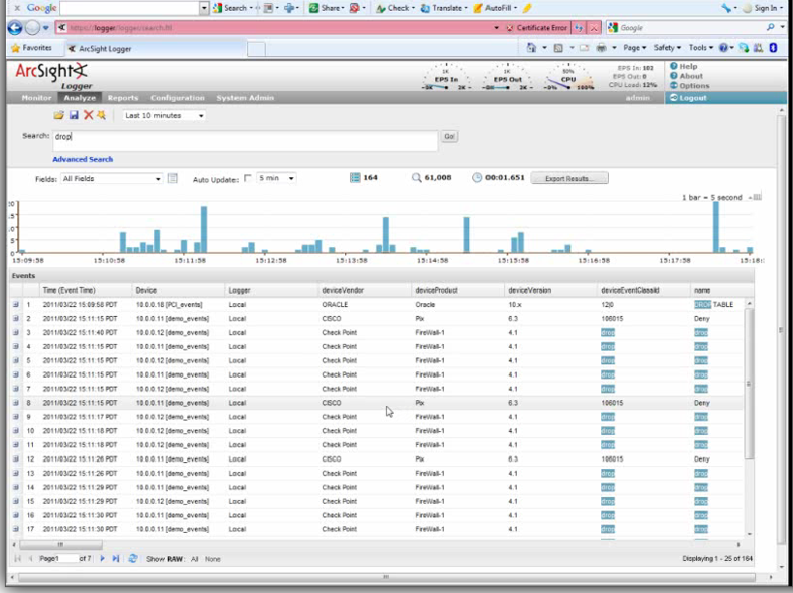
Example: HP ArcSight Goal: examine/browser firewall drops
enter “drop” in search bar.
Results show a time series of drops across multiple firewalls and lists drops
Note that “oracle” is listed
Because the event was “drop Table”
The other events are firewalls

Slide 41

ArcSight fields to be examined

Slide 42
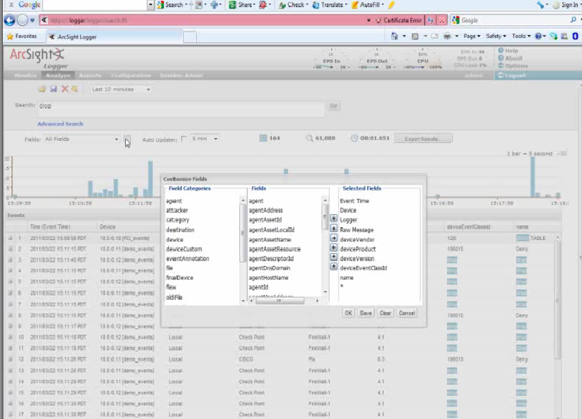
ArcSight allows selection of fields to view
Other tools to ease log search and group different types of events

Slide 43
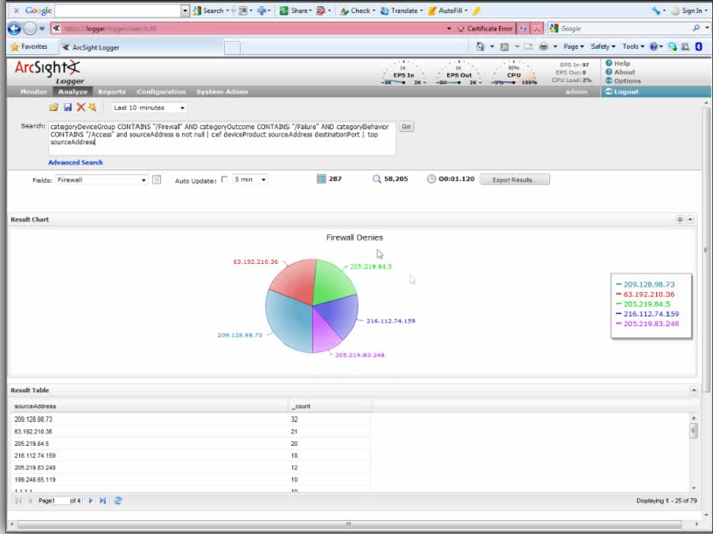
A query can be constructed and a graph of the results can be made
This shows the top 5 source IP address of firewall denies/drops
In any case, manual inspection is very difficult. There is lots of room for improvement

Slide 44
Example Use
Firewall drops
Explore all drops
Clean data
Remove oracle drops
Iterate: Explore and clean (remove irrelevant data)
Explore/find relevant fields
Make query for suspicious events
Save query!
Use browser to search for cause of firewall drop
E.g., the firewall between developers and HR is reporting drops. Who and why is someone in HR trying to access machines in development?
… iterate and save queries
Browsers are very useful.
But why is this not fully automated?
Requires extensive experience
can be time consuming
Easy/tempting to cut corners
“hmm, I think it is normal behavior”

Slide 45
Log management and analysis systems
Many tools
Loggly
Splunk (bought signalFX)
Datadog
ELK Stack: Elasticsearch, Logstash, Kibana
Logstash: collects data from a variety of sources (recall the many components and servers that generate logs)
Kibana: visualization
Elasticsearch: software for searching through large volumes of data

Slide 46
SIEM: Logging and analysis systems
This name is a bit out of date
Why/what
You need to collect lots of logs
You might even write your own code and generate your own logs
Logs are very ugly and unpleasant to work with
SIEM is a single system to handle all your logs
Data collection
Visual analysis
Correlation and specific event detection
Alerting
Automatic Actions
Secure data storage
So that attackers cannot erase their tracks
Security information and event management (SIEM)
Security information management (SIM)
Security event management (SEM)
Sometimes it is hard to tell the difference
Many products
ArcSight (HP)
Splunk – not just for security, analysis of large sets of logs
OSSIM – open source
Cloud providers have SIEMs prebuilt for their clouds
Several others

Slide 47
Key Points
Logging Challenges
Each system, application, and types of data to be logged requires its own sensor
Analysis Challenges
Logs are difficult to understand
Correlating events across different logs is difficult
While specific attacks can be detected, detecting unknown attacks is difficult
Log sanitization
Logs can contain confidential and private data
Sanitization reduces the usefulness of the logs
Anonymization and access control are used
Anonymization is difficult in that some information might be leaked
Log sanitization is difficult
What is logged and when?
Things related to policy
E.g.,
Policy is that Stephan cannot access file X
Audit system for file access must log
Who the user is that is making the request
What file is being request
If the request was granted (don’t forget this one)
State-based vs transition-based
Many other things
Visualization
Off-the-shelve tools

